Slide 1


How to Access Landsat Data from USGS EarthExplorer
Landsats 1-7:
Multispectral over previous time periods
(Mid 1972 – 6th April 2022)
Landsat 9 :
Latest mission
Sept 2021 - Current
+ EarthExplorer has many other USGS datasets e.g. Aerial surveys, DTMs etc
Landsat 8
Multispectral (e.g. Optical)
Feb 2013 - Current

Slide 2
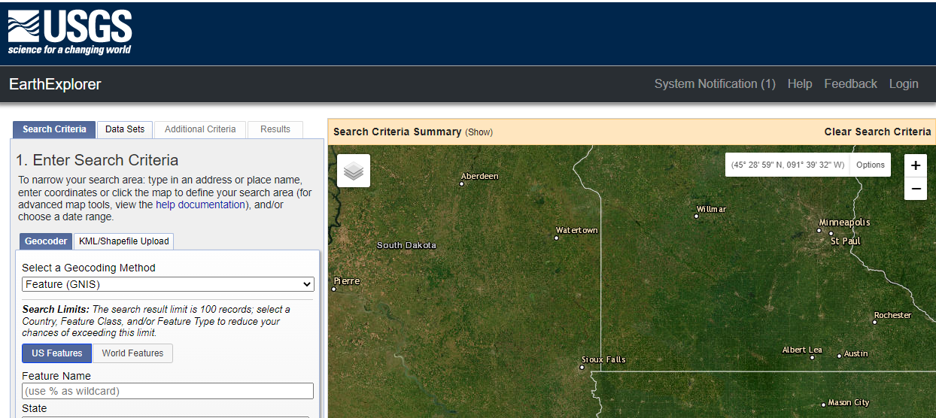
Go to https://earthexplorer.usgs.gov/ and Login / Create an Account

Slide 3
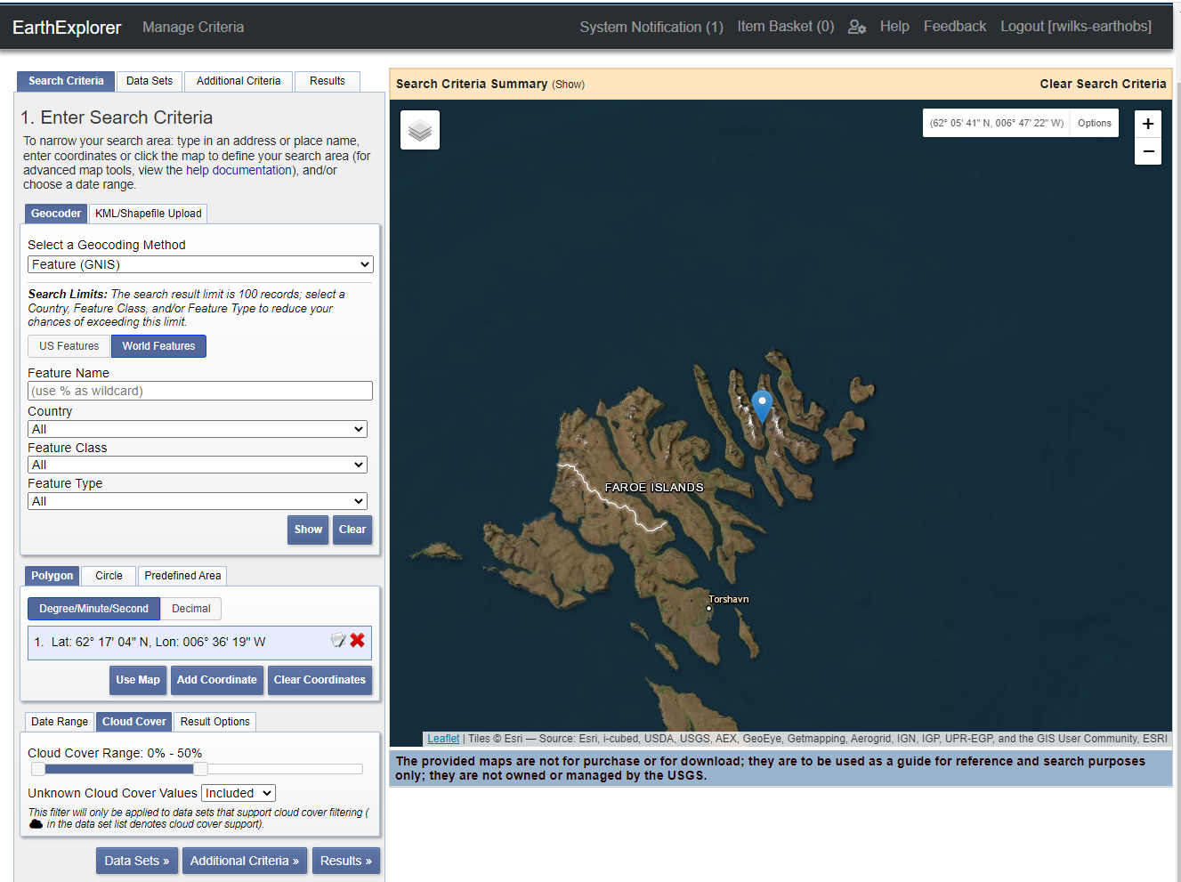
Select an Area of Interest (AOI)
Example below = drop pin to select a coordinate

Slide 4
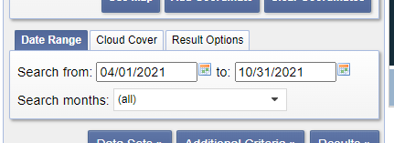
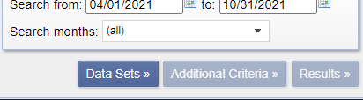
Select a Date Range
Select a Cloud Cover %
Note: For very low % covers e.g. <20% (esp. for Faroe Islands) you will likely need wider date ranges
Click ‘Data Sets’ to select which USGS Data Set you are searching.
e.g. Landsat 8, Aerial Surveys, Other USGS data products etc.

Slide 5
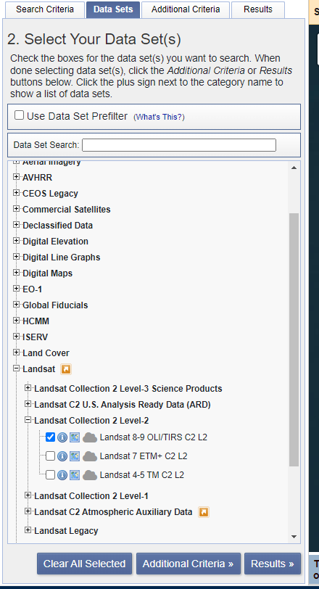
Select the Data Set you want
Want Landsat 8-9 OLI/TIRS C2 L2
-> We are using Level 2 (L2) products across our analysis. Levels 0,1,2,3 are consistent across multispectral satellite providers, however there may be subsets e.g. Level 2A, Level 2B in some.
-> Some examples of typical processing at different levels, atmospheric correction is applied for a Level 2 product.
Select for Results

Slide 6
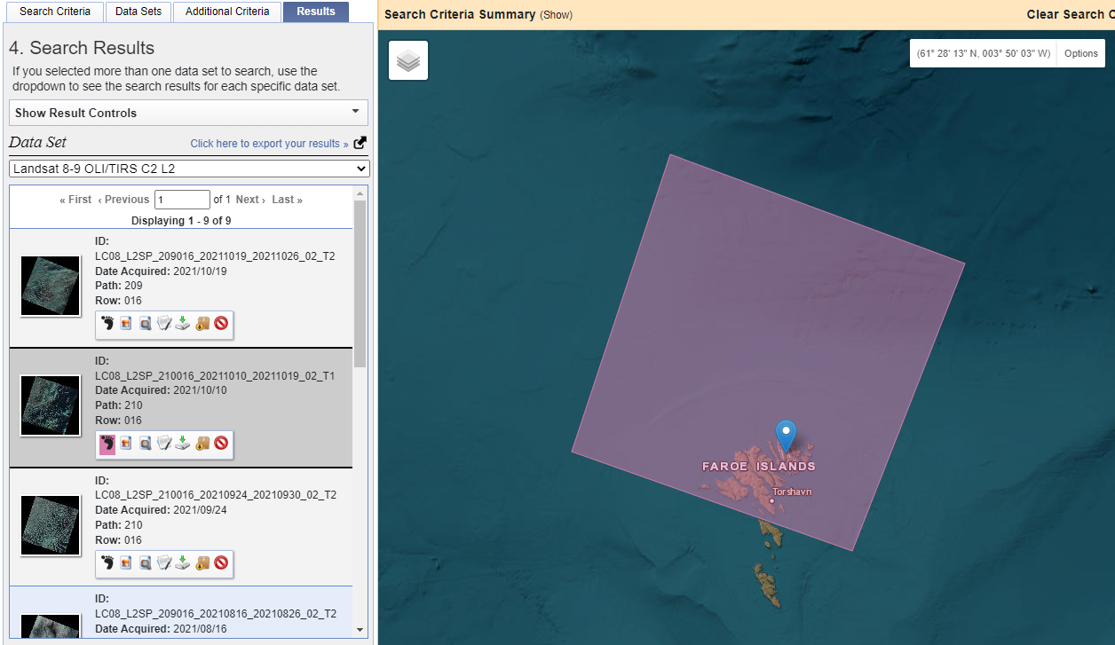

Slide 7
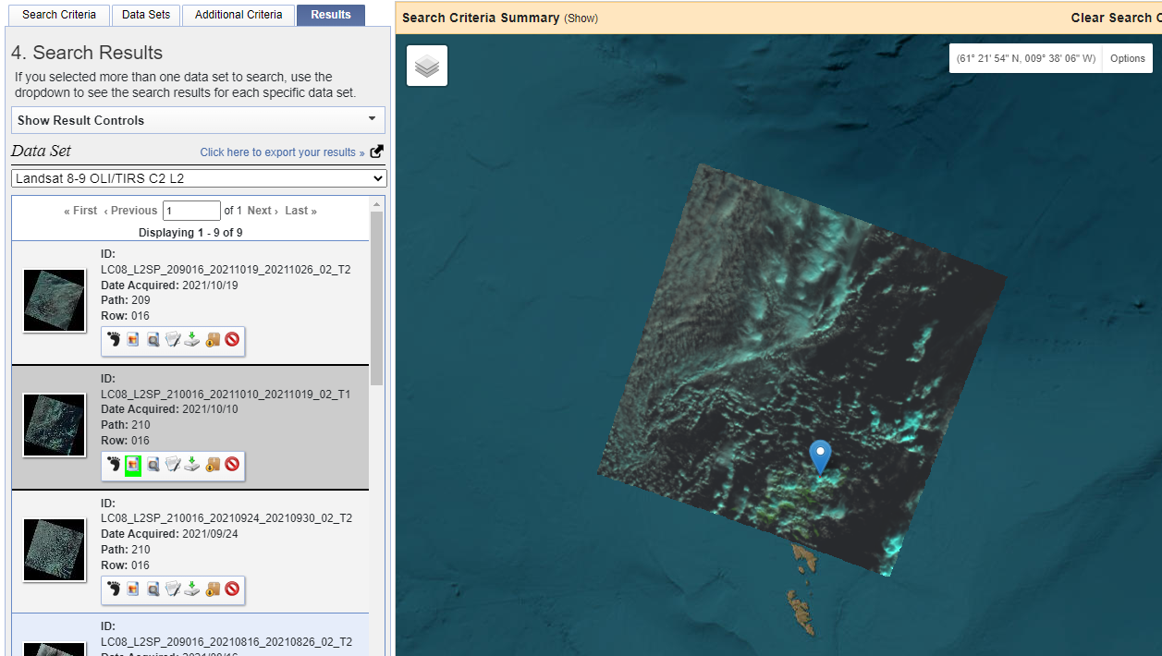

Slide 8
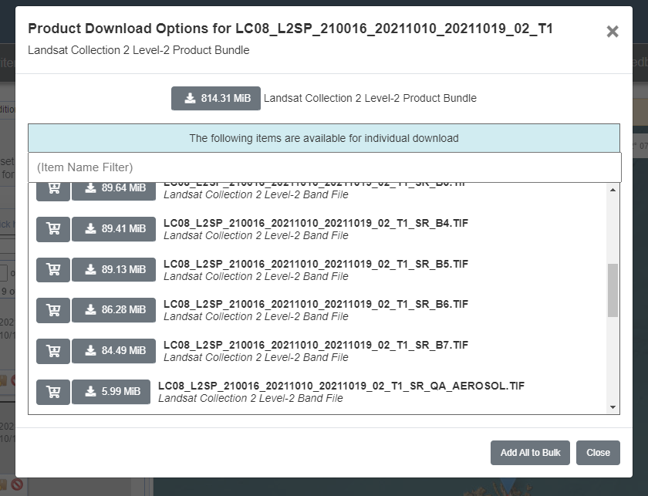
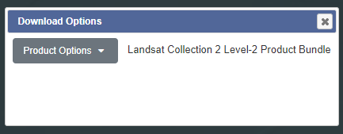

Slide 9
Bands
LC08_L2SP_210016_20211010_20211019_02_T1_SR_B1.TIF Landsat Collection 2 Level-2 Band File
LC08_L2SP_210016_20211010_20211019_02_T1_SR_B2.TIF Landsat Collection 2 Level-2 Band File
LC08_L2SP_210016_20211010_20211019_02_T1_SR_B3.TIF Landsat Collection 2 Level-2 Band File
LC08_L2SP_210016_20211010_20211019_02_T1_SR_B4.TIF Landsat Collection 2 Level-2 Band File
LC08_L2SP_210016_20211010_20211019_02_T1_SR_B5.TIF Landsat Collection 2 Level-2 Band File
LC08_L2SP_210016_20211010_20211019_02_T1_SR_B6.TIF Landsat Collection 2 Level-2 Band File
LC08_L2SP_210016_20211010_20211019_02_T1_SR_B7.TIF Landsat Collection 2 Level-2 Band File
LC08_L2SP_210016_20211010_20211019_02_T1_ST_B10.TIF Landsat Collection 2 Level-2 Band File
Other Data
LC08_L2SP_210016_20211010_20211019_02_T1_ANG.txt Landsat Collection 2 Level-2 Band File
LC08_L2SP_210016_20211010_20211019_02_T1_MTL.txt Landsat Collection 2 Level-2 Band File
LC08_L2SP_210016_20211010_20211019_02_T1_MTL.xml Landsat Collection 2 Level-2 Band File
LC08_L2SP_210016_20211010_20211019_02_T1_QA_PIXEL.TIF Landsat Collection 2 Level-2 Band File
LC08_L2SP_210016_20211010_20211019_02_T1_QA_RADSAT.TIF Landsat Collection 2 Level-2 Band File
LC08_L2SP_210016_20211010_20211019_02_T1_SR_QA_AEROSOL.TIF Landsat Collection 2 Level-2 Band File
LC08_L2SP_210016_20211010_20211019_02_T1_ST_ATRAN.TIF Landsat Collection 2 Level-2 Band File
LC08_L2SP_210016_20211010_20211019_02_T1_ST_CDIST.TIF Landsat Collection 2 Level-2 Band File
LC08_L2SP_210016_20211010_20211019_02_T1_ST_DRAD.TIF Landsat Collection 2 Level-2 Band File
LC08_L2SP_210016_20211010_20211019_02_T1_ST_EMIS.TIF Landsat Collection 2 Level-2 Band File
LC08_L2SP_210016_20211010_20211019_02_T1_ST_EMSD.TIF Landsat Collection 2 Level-2 Band File
LC08_L2SP_210016_20211010_20211019_02_T1_ST_QA.TIF Landsat Collection 2 Level-2 Band File
LC08_L2SP_210016_20211010_20211019_02_T1_ST_TRAD.TIF Landsat Collection 2 Level-2 Band File
LC08_L2SP_210016_20211010_20211019_02_T1_ST_URAD.TIF
TIF files are…

